Slide 1
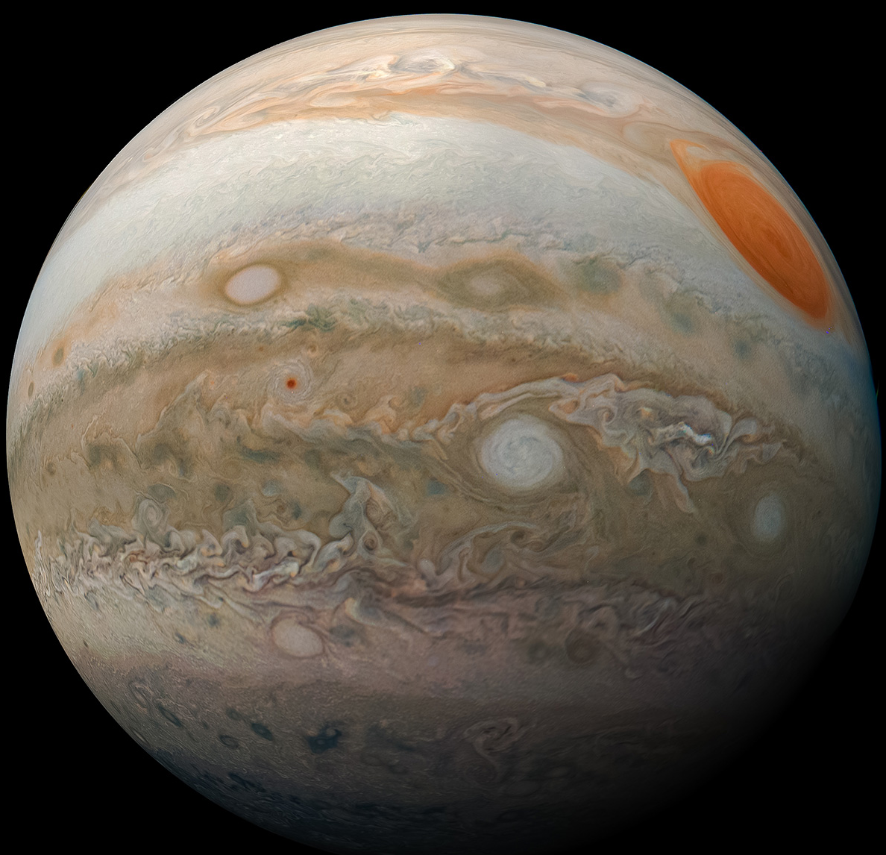

Slide 2
Radius: 66,854 km
Mass: 1,898x10²⁴ kg
Past missions that have studied Jupiter: Pioneer, Voyager, Galileo, Ulysses, Cassini. Juno is currently studying Jupiter.
Jupiter is a fascinating planet to study because of the gaseous composition of the planet and the strong magnetic fields it emits. One of the most prominent features of Jupiter is its Great Red Spot, a gaseous storm that rotates counterclockwise. Humans have been monitoring the spot for over 150 years! The Great Red Spot is located in the southern hemisphere and is wider than Earth. It reaches into the atmosphere for over 300km. That’s a lot! Tropical storms on Earth usually extend for 15km, far surpassing height of Mount Everest. A lesser known fact is that Jupiter also has a Great Blue Spot. This spot is not visible by the human eye. It is an area with an intense magnetic field around Jupiter’s equator. Juno’s magnometer collects data so that scientists can create 3D maps of Jupiter’s magnetic field. We can learn about Earth’s magnetic field by studying Jupiter’s works.
The four Galilean moons: Io, Europa, Ganymede, and Callisto were the first moons discovered that orbit a planet other than Earth. Back in 1610, this was huge news. People still believed that all objects in the solar system rotated around Earth rather than the Sun. This discovery helped us realize what our solar system actually looks like.
Jupiter’s moons Io, Europa, and Ganymede are in resonance, which means that every time Ganymede completes and orbit around Jupiter, Europa has completed its orbit twice, and Io has completed its orbit four times. Eight of Jupiter’s moons, including the four Galilean moons are tidally locked with Jupiter. Tidal locking means an object rotates on its axis at a rate that causes the same side of it to face what it orbits at all times.
79 moons
4,333 Earth days to orbit the sun
Jupiter has rings!
43 minutes for sunlight to get here

Slide 3
https://www.nasa.gov/image-feature/jpl/jupiter-marble

Slide 4
Jupiter
https://www.nasa.gov/image-feature/jpl/jupiter-s-great-red-spot-a-rose-by-any-other-name
The Great Red Spot, southern hemisphere, 1.3x wide as Earth, 320km deep, Earth tropical cyclones about 15km deep, still almost twice as tall as Mount Everest for a cloud. Counterclockwise rotation.
https://www.nasa.gov/feature/goddard/2021/hubble-shows-winds-in-jupiters-great-red-spot-are-speeding-up
Hubble Space Telescope shows increasing average wind speed in The Great Red Spot outer ring, slower in inner ring. Both counterclockwise.
https://solarsystem.nasa.gov/moons/jupiter-moons/europa/in-depth/
Jupiter takes 4,333 Earth days to orbit the Sun
Jupiter’s moons Io, Europa, and Ganymede are in what is called a resonance – every time Ganymede orbits Jupiter once, Europa orbits twice, and Io orbits four times
Callisto, (and others) tidally locked so same side always facing Jupiter
Strong magnetic field to consider
These 4 Jovian moons were the first moons discovered orbiting a planet other than Earth. Led to heliocentricism.
https://image.gsfc.nasa.gov/poetry/venus/q89.html
43 minutes for sunlight to reach Jupiter
https://nssdc.gsfc.nasa.gov/planetary/planets/jupiterpage.html
Missions to Jupiter in chronological order: Pioneer (10, 11), Voyager (2, 1), Galileo (probe, orbiter), Ulysses, Cassini, Juno (current)
Jupiter has rings, but much fainter than Saturn’s rings.
https://www.nasa.gov/feature/jpl/nasas-juno-finds-changes-in-jupiters-magnetic-field
Juno studied in depth. First world beyond Earth with internal magnetic field that changes over time (secular variation).
Characterizing a magnetic field requires close-up measurements. Juno’s magnometer – 3D map of magnetic field.
Pioneer had first magnetic data.
Planet interior changes from gas to highly conductive liquid metal.
The Great Blue Spot, intense patch of magnetic field by equator.

Slide 5
Facts circle
43 minutes for sunlight to reach Jupiter
Jupiter takes 4,333 Earth days to orbit the Sun
Radius: 66,854 km
Mass: 1,898.2x10^24kg
79 moons
Jupiter has rings, but much fainter than Saturn’s rings.

Slide 6
Paragraph
Missions to Jupiter in chronological order: Pioneer (10, 11), Voyager (2, 1), Galileo (probe, orbiter), Ulysses, Cassini, Juno (current)
Jupiter is a fascinating planet to study because of the gaseous composition of the planet and the strong magnetic fields it emits. One of the most prominent features of Jupiter is its Great Red Spot, a gaseous storm that rotates counterclockwise. Humans have been monitoring the spot for over 150 years! The Great Red Spot is located in the southern hemisphere and is wider than Earth. It reaches into the atmosphere for over 300km. That’s a lot! Tropical storms on Earth usually extend for 15km, far surpassing height of Mount Everest. A lesser known fact is that Jupiter also has a Great Blue Spot. This spot is not visible by the human eye. It is an area with an intense magnetic field around Jupiter’s equator. Juno’s magnometer collects data so that scientists can create 3D maps of Jupiter’s magnetic field. We can learn about Earth’s magnetic field by studying Jupiter’s works.
The four Galilean moons: Io, Europa, Ganymede, and Callisto were the first moons discovered that orbit a planet other than Earth. Back in 1610, this was huge news. People still believed that all objects in the solar system rotated around Earth rather than the Sun. This discovery helped us realize what our solar system actually looks like.
Jupiter’s moons Io, Europa, and Ganymede are in resonance, which means that every time Ganymede completes and orbit around Jupiter, Europa has completed its orbit twice, and Io has completed its orbit four times. Eight of Jupiter’s moons, including the four Galilean moons are tidally locked with Jupiter. Tidal locking means an object rotates on its axis at a rate that causes the same side of it to face what it orbits at all times.

